Slide 1
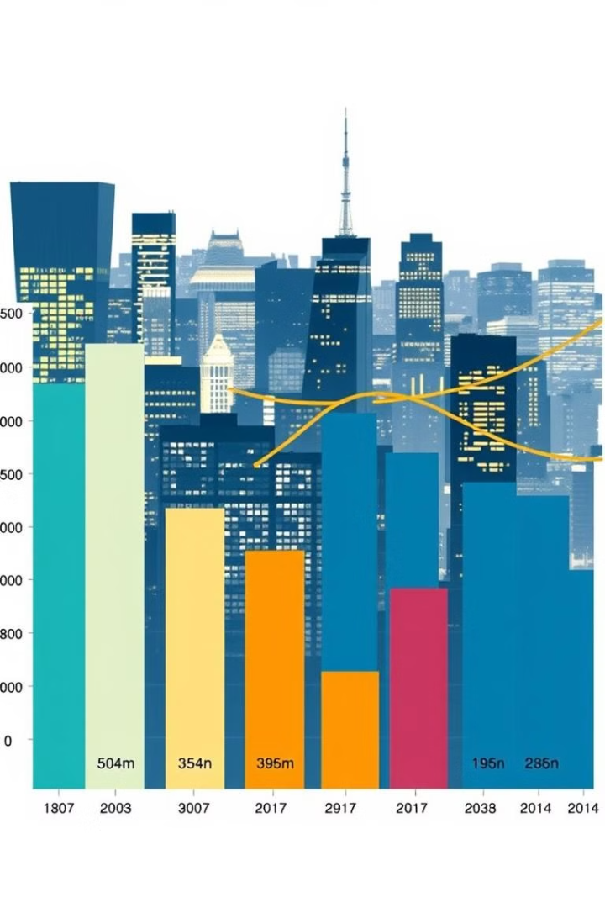
Energy Consumption Analysis and Recommendations
This presentation analyzes energy consumption data and provides actionable insights and recommendations for optimization.

Slide 2
Overview of Energy Usage Data
Dataset Overview
Key Variables
Power Demand.csv: This dataset contains energy consumption demand every half hour interval, the dataset has 2 columns
The data included energy consumption by [DateTime , Site_id , Cell_id , KWH/hh (per half hour)
The data included Demand by DemandDateTime , Demand
Energy Consumption.csv: This dataset contains energy consumption data collected from network sites, to help us monitor and track sites’ energy consumption, the dataset has 5 columns

Slide 3

Objectives
1
Does the region significantly affect energy consumption?
2
Is there a relationship between time of day and energy consumption?
3
Recommend a threshold for shutting down cells with low consumption.
4
Quantify savings in energy (KWh) and cost (EGP).

Slide 4


Conclusion and Key Insights
Key Insight
1
Significant opportunities for energy savings.
Evidence
2
Unnecessary consumption during off-peak hours.

Slide 5

Regional Insights: Region A & B have the highest power consumption. Region D has the lowest power consumption but does not report zero consumption. Statistical test (ANOVA) confirmed a significant difference in energy consumption across regions with a p-value of 0.0 (Reject 𝐻 0 H 0 ​ ).
Temporal Insights: Energy consumption peaks between 19:00 (7 PM) and 21:00 (9 PM), with the highest demand observed from 17:00 to 21:30. Energy consumption is lowest between midnight and 6:00 AM across all days. Fridays and Saturdays show a noticeable increase in evening energy usage.
Seasonal Trends: January recorded the highest energy consumption, while a steady decline was observed from January to July 2013.
Savings from Threshold Optimization: Threshold applied: 0.12 KWh (above 25%, below median). Energy saved: 24,094 KWh. Cost saved: 4,935 EGP.

Slide 6
Methodology
Data Preparation
1
Cleaned data for missing and duplicate values.
Parsed DateTime and engineered features: Day_of_Week, Hour, Month.
2
Exploratory Data Analysis
I
Conducted ANOVA to test the effect of regions on energy consumption.
Optimization
Analyzed hourly energy consumption patterns.
3
Visualized temporal and regional trends.
Applied a threshold (0.12) to identify low-consumption cells.
Calculated energy and cost savings.

Slide 7
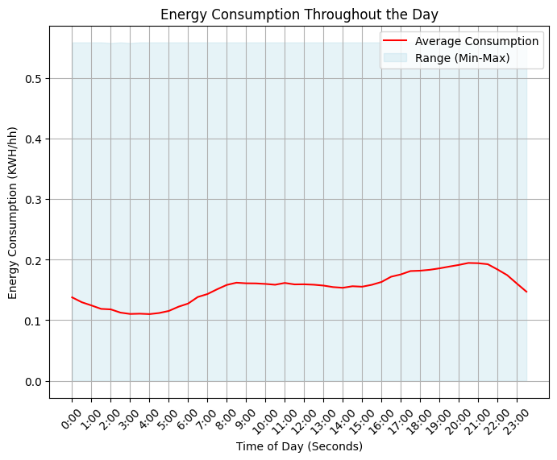
Pre-Modeling Insights
Energy Consumption Trends
Regional Consumption
Regions A & B have the highest consumption; Region D the lowest.
Peaks in the evening (17:00–21:30).
Declines from January to July with minimal variation across days.
Demand and Time
High demand during evenings and weekends.

Slide 8



Statistical Validation
Does the region significantly affect energy consumption?
ANOVA Test:
Null Hypothesis (H0H_0H0​): Region does not significantly affect energy consumption.
Alternative Hypothesis (H1H_1H1​): Region significantly affects energy consumption.
p-value = 0.0 → Reject H0H_0H0​. Region significantly affects energy consumption.
Is there a relationship between time of day and energy consumption?
Strong correlation between time of day and energy consumption.
Peak usage observed during evening hours.

Slide 9
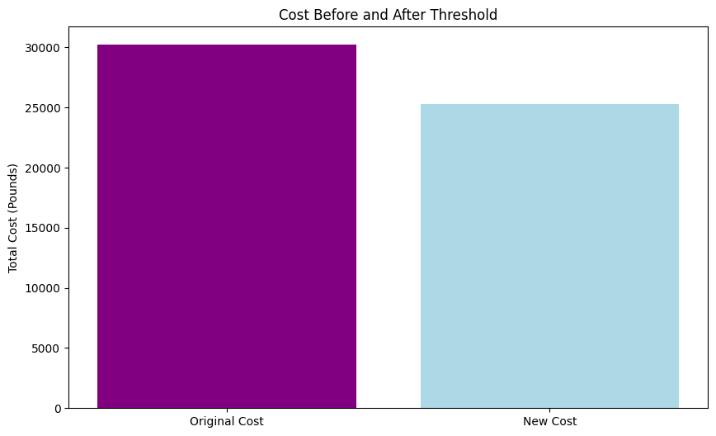
Recommended Threshold
Power consumption: 0.12 KWh (above 25%, below median).
Energy Savings:
24,094 KWh saved by shutting down low-consumption cells.
Cost Savings:
4,935 EGP saved.

Slide 10
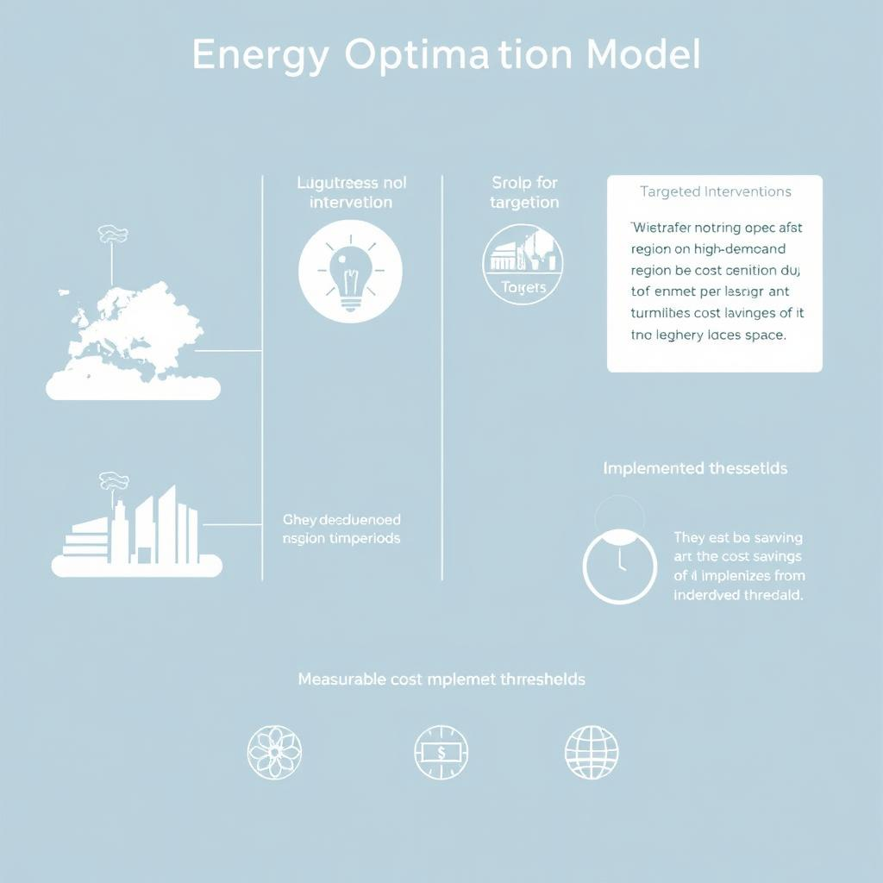
Post-Modeling Insights
Energy Optimization
Low-consumption cells identified and shut down.
Region and Time Focus:
Regions A & B require targeted interventions for demand-side management.
Evening peaks (17:00–21:30) need further optimization
Cost Reduction:
Implementing thresholds resulted in measurable savings

Slide 11
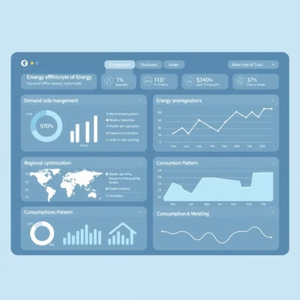

Recommendations
Short-Term Actions:
Implement demand-side management strategies during evening peak hours.
Optimize regions A & B for energy efficiency.
Long-Term Actions:
Monitor energy consumption patterns across all regions to identify inefficiencies.
Continue applying thresholds and explore seasonal/temporal optimizations.

Slide 12
Recommendations
Short-Term Actions:
Implement demand-side management strategies during evening peak hours.
Optimize regions A & B for energy efficiency.
Long-Term Actions:
Monitor energy consumption patterns across all regions to identify inefficiencies.
Continue applying thresholds and explore seasonal/temporal optimizations.

Slide 13
Conclusion
The analysis confirms that region and time of day significantly affect energy consumption.
Threshold optimization results in measurable energy and cost savings.
Recommendations provided for further improvements and scalability.

Slide 14
Notebook link
https://colab.research.google.com/drive/1Q8YaZDsEnPPuNnh3URQmxkPtcDBPh6yY?usp=drive_link

Slide 15


